Slide 1
DATA612 Project 2 Content-Based and Collaborative Filtering
Jun Pan
June 18, 2019

Slide 2
Goal
The goal of this assignment is for you to try out different ways of implementing and configuring a recommender, and to evaluate your different approaches.

Slide 3
The MovieLens 1M Dataset¶
One of the most common datasets that is available on the internet for building a Recommender System is the MovieLens DataSet.
MovieLens 1M Dataset contains 1,000,209 anonymous ratings of approximately 3,900 movies made by 6,040 MovieLens users who joined MovieLens in 2000.
The data was collected by GroupLens researchers over various periods of time, depending on the size of the set. This 1M version was released on February 2003. Users were selected at random for inclusion. All users selected had rated at least 20 movies. Each user is represented by an id, and no other information is provided.

Slide 4
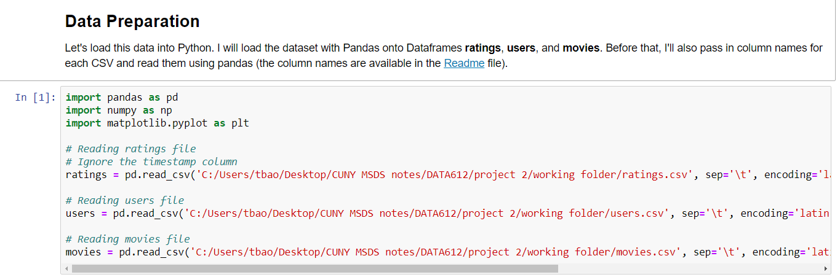
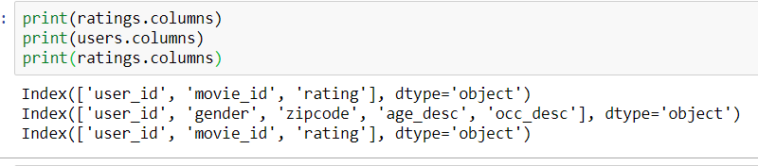
Get Data
Columns of each sub-dataset

Slide 5
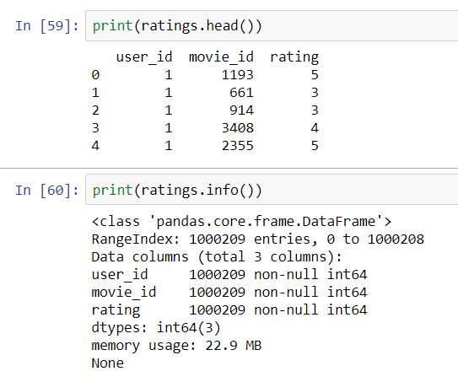
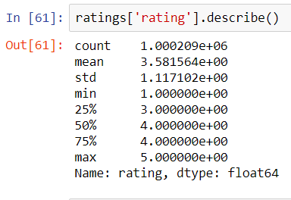
Overview ratings dataset

Slide 6
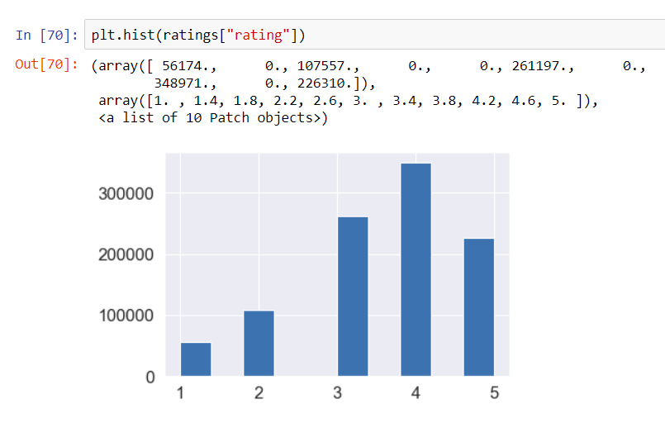
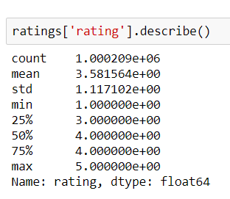
Overall rating
Users are very generous to rate the movies. So the overall distribution of ratings are right skewed.

Slide 7
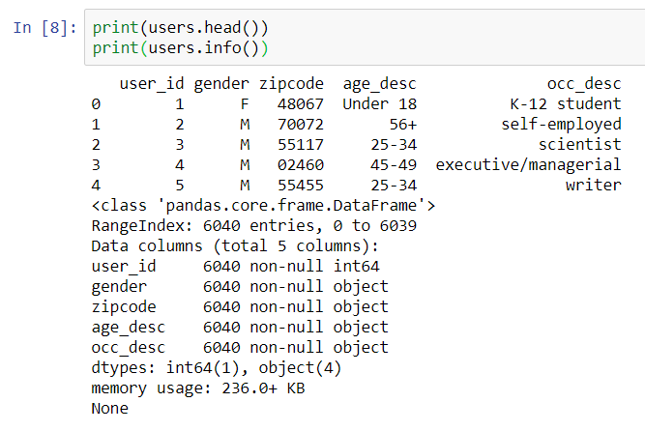
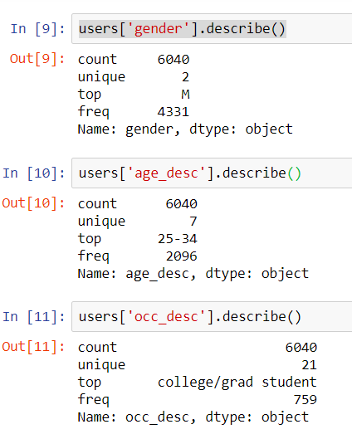
Overview users dataset

Slide 8
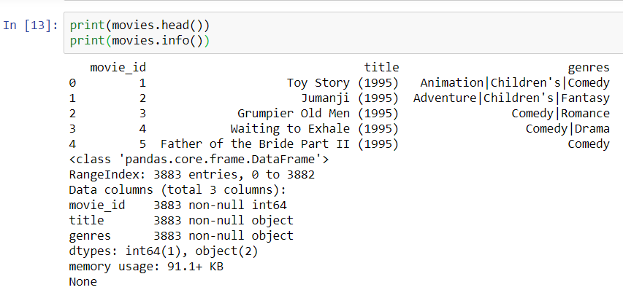
Overview of movies dataset

Slide 9
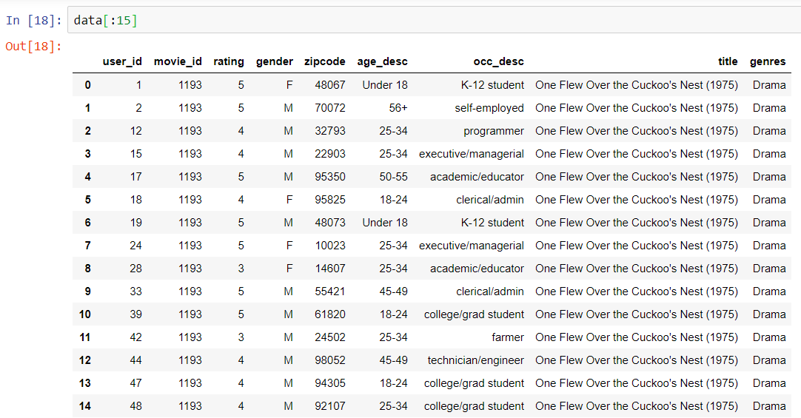
Merge (users, movies and ratings)

Slide 10
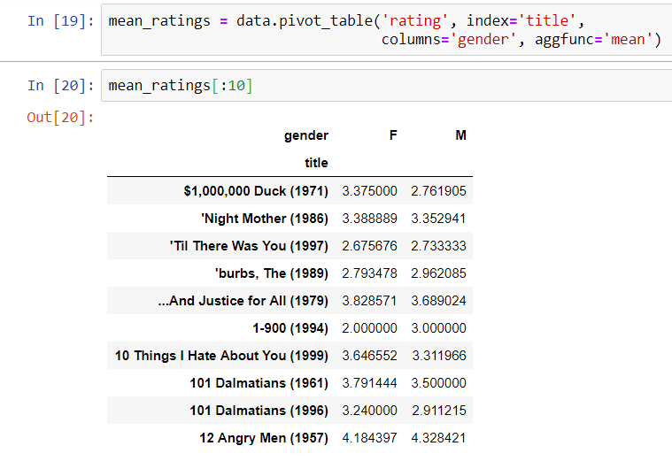
Mean ratings by gender

Slide 11
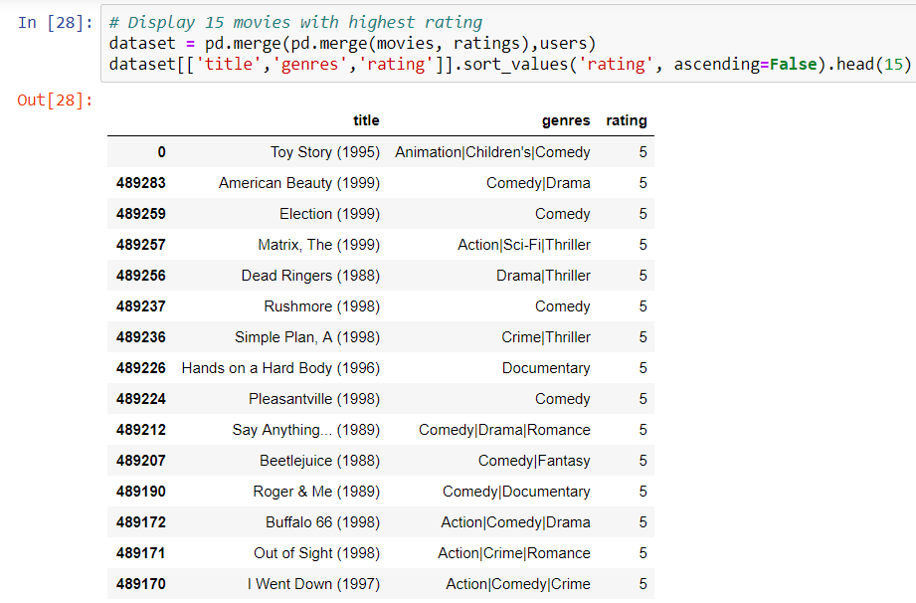
Top 15 rating movies

Slide 12
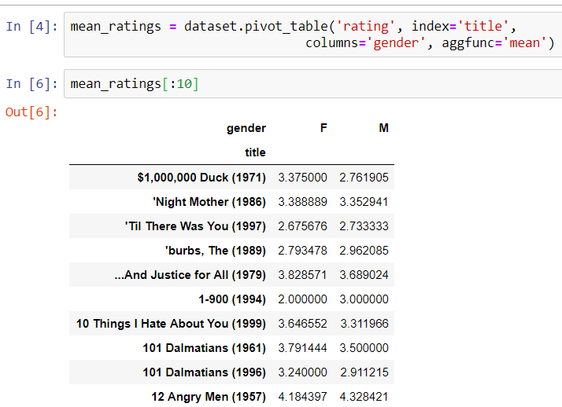
Get mean rating by gender of users show first 10 results

Slide 13
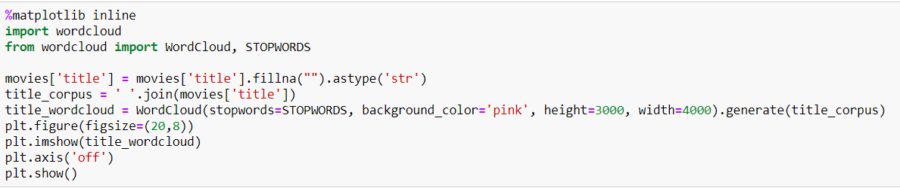
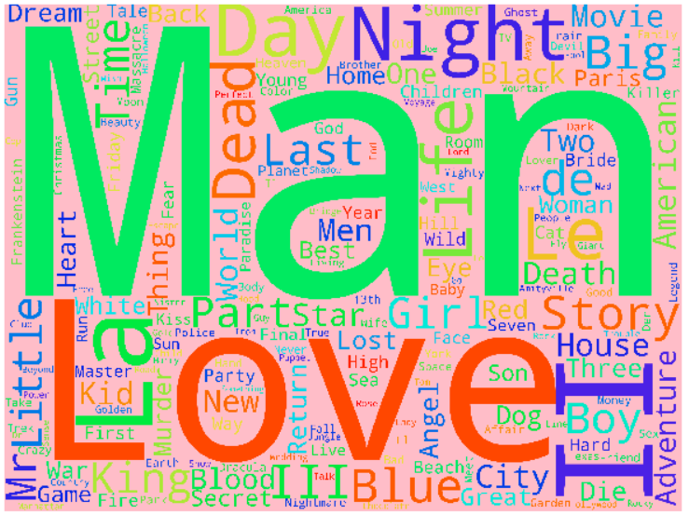
Most popular words in titles

Slide 14
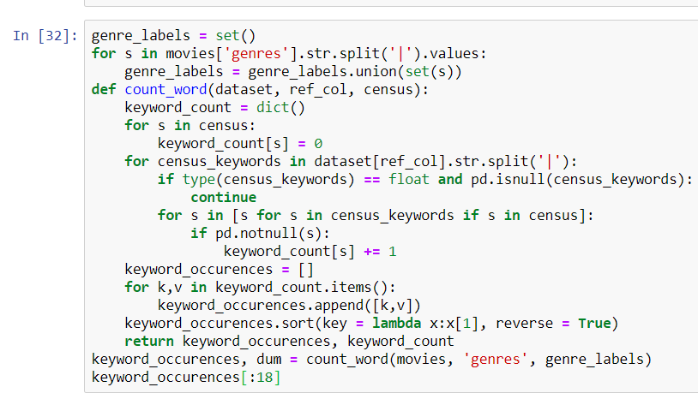
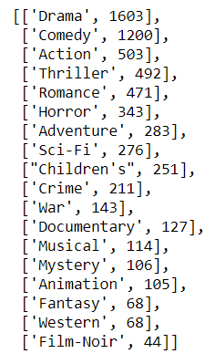
Rank of Genre

Slide 15
Contend Based Recommender Engine
Items (content) are described by a feature set and we use only the target user’s history. A content based recommender works with data that the user provides, either explicitly movie ratings for the MovieLens dataset. Based on that data, a user profile is generated, which is used to make suggestions to the user. As the user provides more inputs or takes actions on the recommendations, the engine becomes more and more accurate.
Implementation:
To build a Content-Based Recommendation Engine that computes similarity between movies based on movie genres. It will suggest movies that are most similar to a particular movie based on its genre by using the file movies.csv.

Slide 16
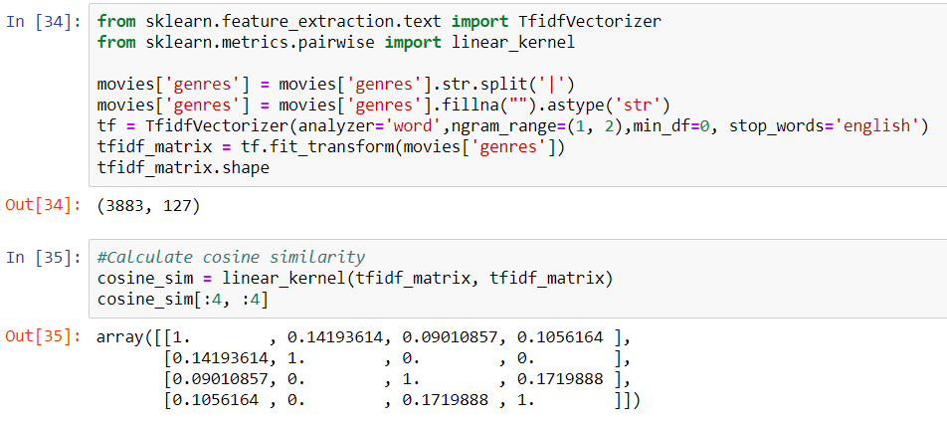
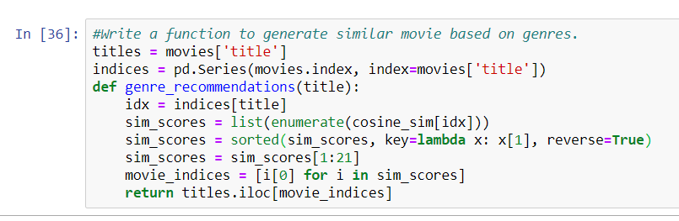

Slide 17
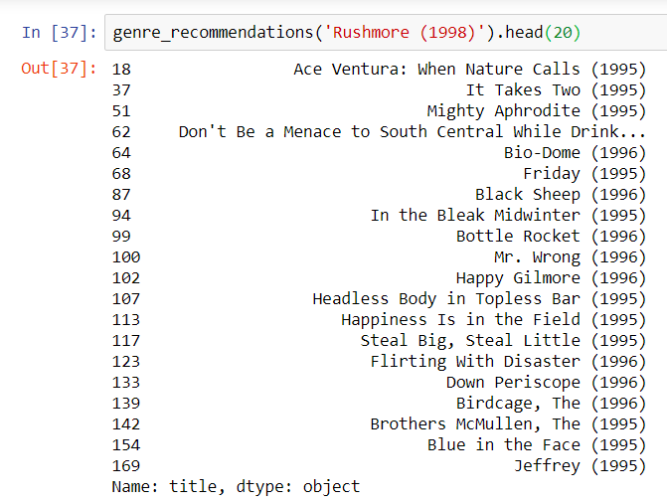
Test Content Based Recommendation Engine

Slide 18
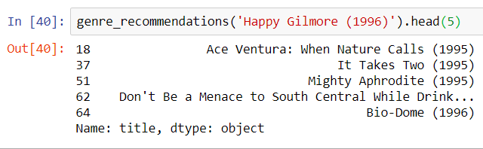
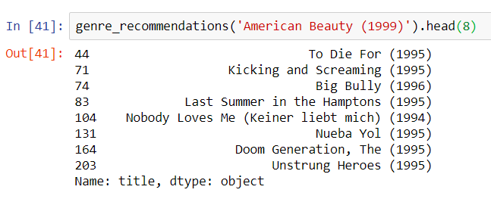

Slide 19
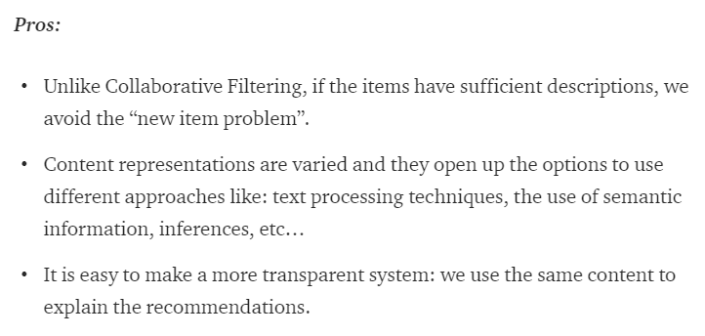
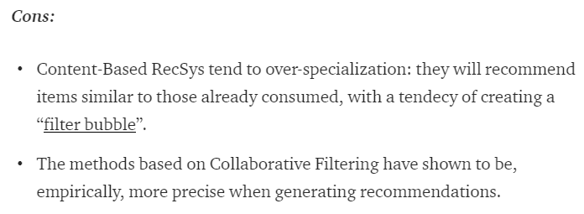
Pros & Cons

Slide 20
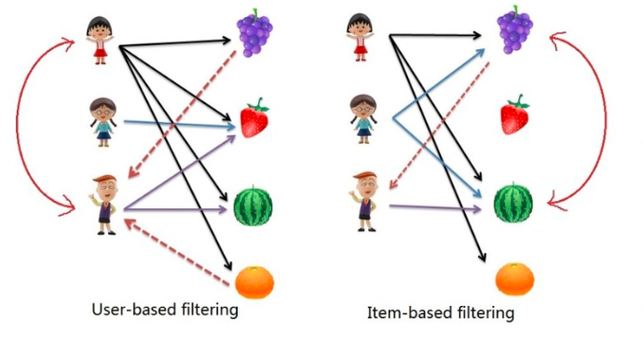
Recommender Systems — User-Based and Item-Based Collaborative Filtering

Slide 21
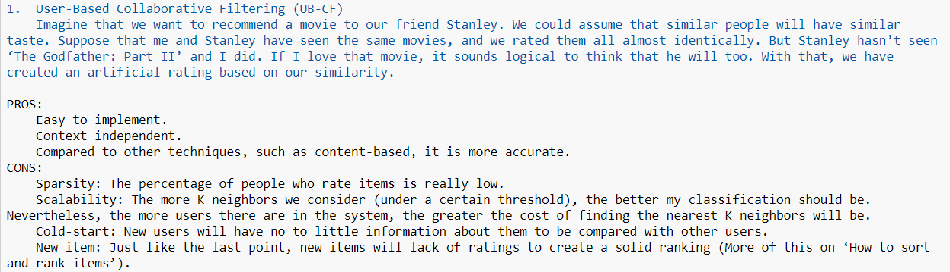
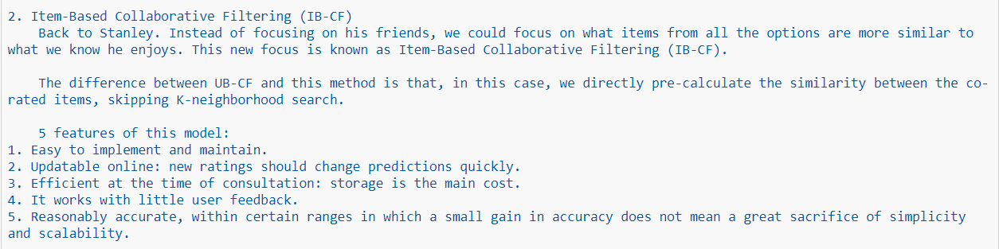

Slide 22
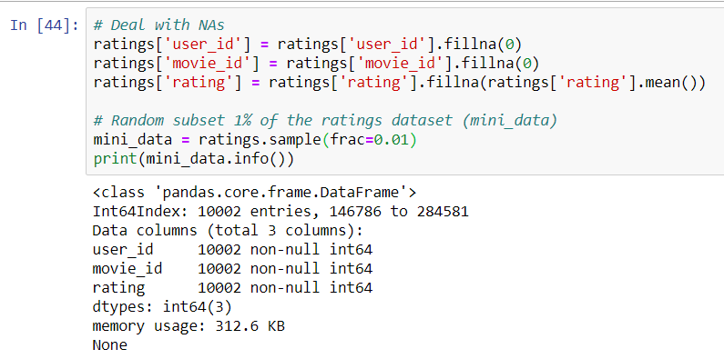
Implementation
1. Ratings dataset will be used.
2. Due to limited power of computer, 1% of data (about 10,000 observers) will be used in this study.

Slide 23
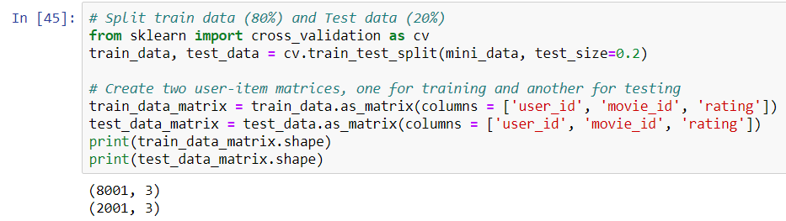
Split Train and Test Data (0.8:0.2)

Slide 24
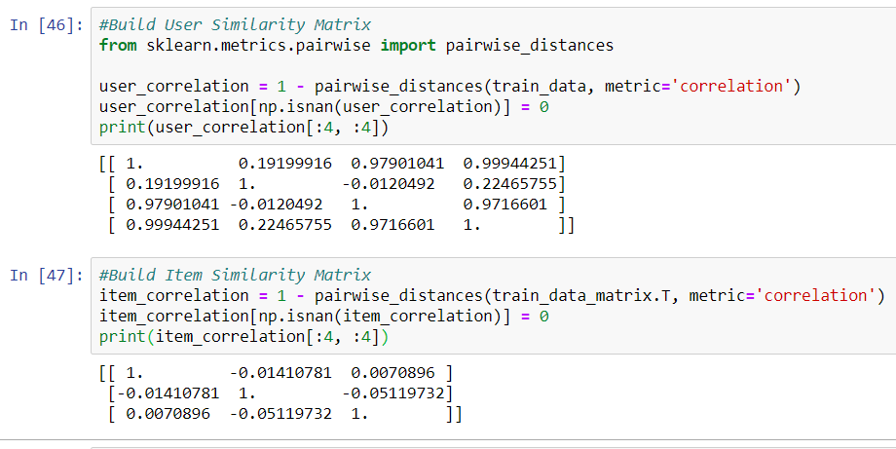
Build User Similarity Matrix & Item Similarity Matrix

Slide 25
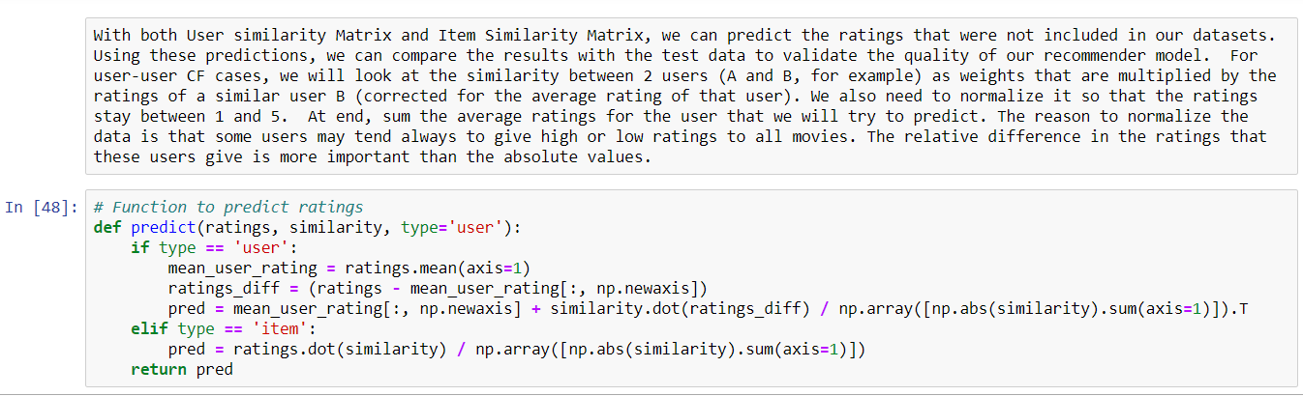
Normalization and Prediction

Slide 26
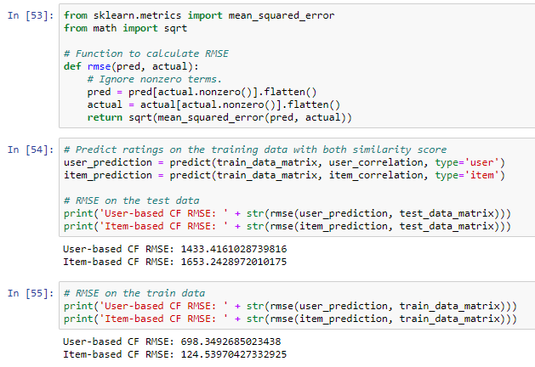
Evaluation Models by RMSE
In general, we can see the RMSE values are quite big. Because we have limited information to make recommendation in this case. Interestingly, RMSE is smaller in User based model than Item based model in test dataset. In contrary, RMSE is bigger in User based dataset than Item based dataset in train dataset.

Slide 27
Summary
In summary, Memory-based Collaborative Filtering is easy to implement and produce reasonable prediction quality. However, there are some drawback of this approach:
It doesn't address the well-known cold-start problem, for example, when new user or new item enters the system.
It can't deal with sparse data, which means it's hard to find users that have rated the same items.
It suffers when new users or items that don't have any ratings enter the system.
It tends to recommend popular items.

